Slide 1

Cryptography
Sixth Edition
by William Stallings
Notes:
Lecture slides prepared for “Cryptography and Network Security”, 6/e, by William Stallings, Chapter 10 – “Other Public-Key Cryptosystems”.

Slide 2
Chapter 10
Other Public-Key Cryptosystems
Notes:
This chapter begins with a description of one of the earliest and simplest PKCS: Diffie-
Hellman key exchange. The chapter then looks at another important scheme, the
Elgamal PKCS. Next, we look at the increasingly important PKCS known as elliptic
curve cryptography. Finally, the use of public-key algorithms for pseudorandom number
generation is examined.

Slide 3
Diffie-Hellman Key Exchange
First published public-key algorithm
A number of commercial products employ this key exchange technique
Purpose is to enable two users to securely exchange a key that can then be used for subsequent symmetric encryption of messages
The algorithm itself is limited to the exchange of secret values
Its effectiveness depends on the difficulty of computing discrete logarithms
Notes:
The first published public-key algorithm appeared in the seminal paper by Diffie
and Hellman that defined public-key cryptography [DIFF76b] and is generally
referred to as Diffie-Hellman key exchange. A number of commercial products
employ this key exchange technique.
The purpose of the algorithm is to enable two users to securely exchange a
key that can then be used for subsequent symmetric encryption of messages. The
algorithm itself is limited to the exchange of secret values.
The Diffie-Hellman algorithm depends for its effectiveness on the difficulty of
computing discrete logarithms. Briefly, we can define the discrete logarithm in the
following way. Recall from Chapter 8 that a primitive root of a prime number p is
one whose powers modulo p generate all the integers from 1 to p - 1. That is, if a
is a primitive root of the prime number p , then the numbers
a mod p , a² mod p , . . . , a^{p-1} mod p
are distinct and consist of the integers from 1 through p - 1 in some permutation.
For any integer b and a primitive root a of prime number p , we can find a
unique exponent i such that
b = a^{i} (mod p ) where 0 ≤ i ≤ (p - 1)
The exponent i is referred to as the discrete logarithm of b for the base a , mod p .
We express this value as dlog_{a,p} (b ). See Chapter 8 for an extended discussion of
discrete logarithms.

Slide 4
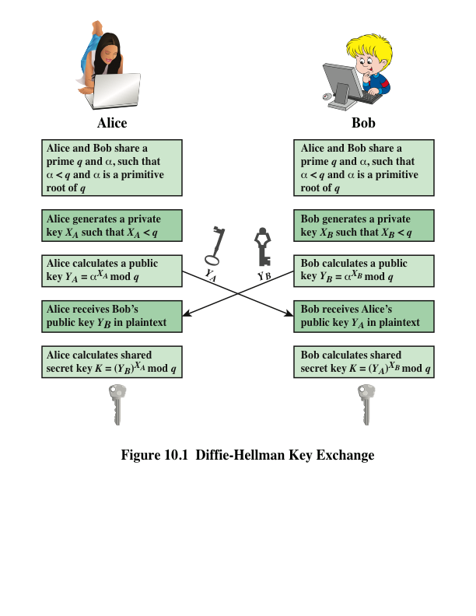
Notes:
Figure 10.1 summarizes the Diffie-Hellman key exchange algorithm. For this
scheme, there are two publicly known numbers: a prime number q and an integer a
that is a primitive root of q .

Slide 5
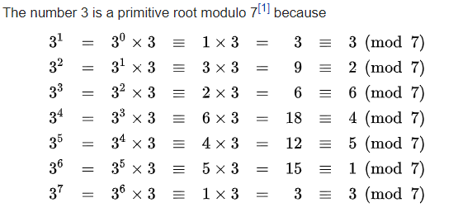
Primitive root example

Slide 6
Key Exchange Protocols
Users could create random private/public Diffie-Hellman keys each time they communicate
Users could create a known private/public Diffie-Hellman key and publish in a directory, then consulted and used to securely communicate with them
Vulnerable to Man-in-the-Middle-Attack
Authentication of the keys is needed
Notes:
Now consider a simple protocol that makes use of the Diffie-Hellman calculation. Suppose that user A wishes to set up a connection with user B and use a secret key to encrypt messages on that connection. User A can generate a one-time private key X_{A}, calculate Y_{A}, and send that to user B. User B responds by generating a private value X_{B}, calculating Y_{B}, and sending Y_{B} to user A. Both users can now calculate the key. The necessary public values q and a would need to be known ahead of time. Alternatively, user A could pick values for q and a and include those in the first message.

Slide 7
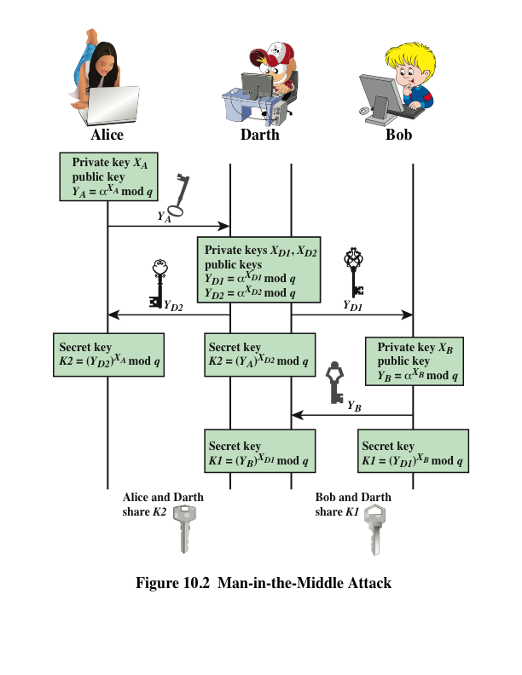
Notes:
The protocol depicted in Figure 10.1 is insecure against a man-in-the-middle attack.
Suppose Alice and Bob wish to exchange keys, and Darth is the adversary. The
attack proceeds as follows (Figure 10.2).
Darth prepares for the attack by generating two random private keys X_{D1} and X_{D2} and then computing the corresponding public keys Y_{D1} and Y_{D2}
Alice transmits Y_{A} to Bob.
Darth intercepts Y_{A} and transmits Y_{D1} to Bob. Darth also calculates K2 = (Y_{A} )^ X_{D2} mod q
Bob receives Y_{D1} and calculates K1=(Y_{D1} )^ X_{B} mod q
Bob transmits Y_{B} to Alice.
Darth intercepts Y_{B} and transmits Y_{D2} to Alice. Darth calculates K1=(Y_{B} )^ X_{D1} mod q
Alice receives Y_{D2} and calculates K2=(Y_{D2} )^ X_{A} mod q .
At this point, Bob and Alice think that they share a secret key, but instead Bob and Darth share secret key K1 and Alice and Darth share secret key K2. All future communication between Bob and Alice is compromised in the following way:
Alice sends an encrypted message M: E(K2, M).
Darth intercepts the encrypted message and decrypts it, to recover M.
Darth sends Bob E(K1, M) or E(K1, M'), where M' is any message. In the first case, Darth simply wants to eavesdrop on the communication without altering it. In the second case, Darth wants to modify the message going to Bob.
The key exchange protocol is vulnerable to such an attack because it does not authenticate the participants. This vulnerability can be overcome with the use of digital signatures and public- key certificates.

Slide 8
ElGamal Cryptography
Announced in 1984 by T. Elgamal (closely related to the Diffie-Hellman technique)
Public-key scheme based on discrete logarithms closely related to the Diffie-Hellman technique
Used in the digital signature standard (DSS) and the S/MIME e-mail standard
Global elements are a prime number q and a which is a primitive root of q
Security is based on the difficulty of computing discrete logarithms
Notes:
In 1984, T. Elgamal announced a public-key scheme based on discrete logarithms, closely related to the Diffie-Hellman technique [ELGA84, ELGA85]. The ElGamal cryptosystem is used in some form in a number of standards including the digital signature standard (DSS) and the S/MIME email standard.
As with Diffie-Hellman, the global elements of ElGamal are a prime number q and a, which is a primitive root of q. User A generates a private/public key pair as shown. The security of ElGamal is based on the difficulty of computing discrete logarithms, to recover either x given y, or k given K .
The security of Elgamal is based on the difficulty of computing discrete
logarithms.

Slide 9
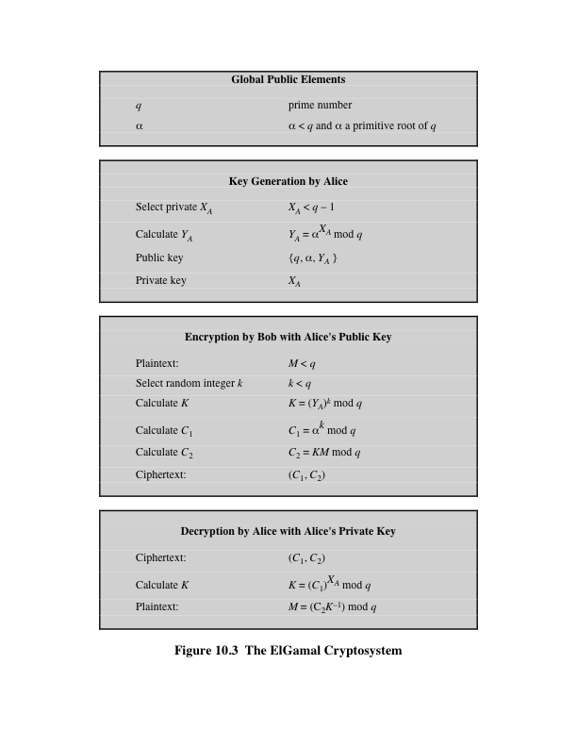
Notes:
Figure 10.3 summarizes the ElGamal Cryptosystem. It corresponds to Figure 9.1a.

Slide 10
Elliptic Curve Arithmetic
Most of the products and standards that use public-key cryptography for encryption and digital signatures use RSA
  The key length for secure RSA use has increased over recent years and this has put a heavier processing load on applications using RSA
Elliptic curve cryptography (ECC) is showing up in standardization efforts including the IEEE P1363 Standard for Public-Key Cryptography
Principal attraction of ECC is that it appears to offer equal security for a far smaller key size
Confidence level in ECC is not yet as high as that in RSA
Notes:
Most of the products and standards that use public-key cryptography for encryption
and digital signatures use RSA. As we have seen, the key length for secure RSA
use has increased over recent years, and this has put a heavier processing load on
applications using RSA. This burden has ramifications, especially for electronic commerce
sites that conduct large numbers of secure transactions. A competing system
challenges RSA: elliptic curve cryptography (ECC). ECC is showing up in standardization
efforts, including the IEEE P1363 Standard for Public-Key Cryptography.
The principal attraction of ECC, compared to RSA, is that it appears to offer
equal security for a far smaller key size, thereby reducing processing overhead. On
the other hand, although the theory of ECC has been around for some time, it is
only recently that products have begun to appear and that there has been sustained
cryptanalytic interest in probing for weaknesses. Accordingly, the confidence level
in ECC is not yet as high as that in RSA.
ECC is fundamentally more difficult to explain than either RSA or Diffie-
Hellman, and a full mathematical description is beyond the scope of this book.
This section and the next give some background on elliptic curves and ECC. We
begin with a brief review of the concept of abelian group. Next, we examine the
concept of elliptic curves defined over the real numbers. This is followed by a look
at elliptic curves defined over finite fields. Finally, we are able to examine elliptic
curve ciphers.

Slide 11
Abelian Group
A set of elements with a binary operation, denoted by •, that associates to each ordered pair (a, b) of elements in G an element (a • b) in G, such that the following axioms are obeyed:
(A1) Closure: If a and b belong to G, then a • b is also in G
(A2) Associative: a • (b • c) = (a • b) • c for all a, b, c in G
(A3) Identity element: There is an element e in G such that a • e = e • a = a for all a in G
(A4) Inverse element: For each a in G there is an element a′ in G such that a • a′ = a′ • a = e
(A5) Commutative: a • b = b • a for all a, b in G
Notes:
Recall from Chapter 4 that an abelian group G , sometimes denoted by {G , . }, is
a set of elements with a binary operation, denoted by . , that associates to each
ordered pair (a , b ) of elements in G an element (a . b ) in G , such that the following
axioms are obeyed:
(A1) Closure: If a and b belong to G , then a . b is also in G .
(A2) Associative: a . (b . c ) = (a . b ) . c for all a , b , c in G .
(A3) Identity element: There is an element e in G such that a . e = e . a = a
for all a in G .
(A4) Inverse element: For each a in G there is an element a′ in G such that
a . a′ = a′ . a = e.
(A5) Commutative: a . b = b . a for all a , b in G .

Slide 12
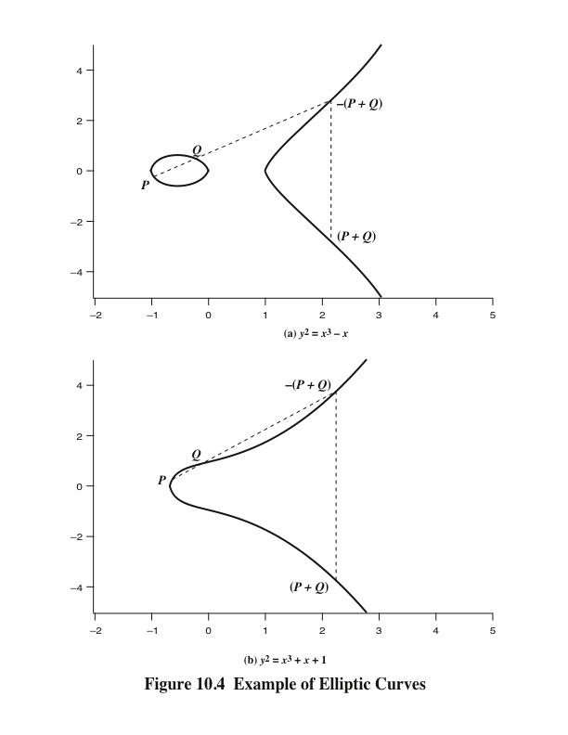
Notes:
Elliptic curves are not ellipses. They are so named because they are described by
cubic equations, similar to those used for calculating the circumference of an ellipse.
In general, cubic equations for elliptic curves take the following form, known as a
Weierstrass equation:
y² + axy + by = x³ + cx² + dx + e
where a , b , c , d , e are real numbers and x and y take on values in the real numbers.
For our purpose, it is sufficient to limit ourselves to equations of the form
y² = x³ + ax + b
Such equations are said to be cubic, or of degree 3, because the highest
exponent they contain is a 3. Also included in the definition of an elliptic curve is a
single element denoted O and called the point at infinity or the zero point , which we
discuss subsequently. To plot such a curve, we need to compute
y = √x³ + ax + b
For given values of a and b , the plot consists of positive and negative values of y for
each value of x . Thus, each curve is symmetric about y = 0. Figure 10.4 shows two
examples of elliptic curves. As you can see, the formula sometimes produces weird looking
curves.
Now, consider the set of points E(a , b ) consisting of all of the points (x , y ) that
satisfy Equation (10.1) together with the element O . Using a different value of the
pair (a , b ) results in a different set E(a , b ). Using this terminology, the two curves in
Figure 10.4 depict the sets E(- 1, 0) and E(1, 1), respectively.

Slide 13
Elliptic Curves Over Z_{p}
Elliptic curve cryptography uses curves whose variables and coefficients are finite
Two families of elliptic curves are used in cryptographic applications:
Prime curves over Z_{p}
Use a cubic equation in which the variables and coefficients all take on values in the set of integers from 0 through p-1 and in which calculations are performed modulo p
Best for software applications
Binary curves over GF(2^{m})
Variables and coefficients all take on values in GF(2^{m}) and in calculations are performed over GF(2^{m})
Best for hardware applications
Notes:
Elliptic curve cryptography makes use of elliptic curves in which the variables and coefficients are all restricted to elements of a finite field. Two families of elliptic curves are used in cryptographic applications: prime curves over Z_{p} (best for software use), and binary curves over GF(2^{m}) (best for hardware use).
There is no obvious geometric interpretation of elliptic curve arithmetic over finite fields. The algebraic interpretation used for elliptic curve arithmetic over does readily carry over. See text for detailed discussion.

Slide 14
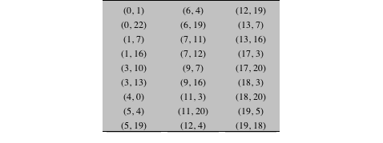
Table 10.1
Points (other than O) on the Elliptic Curve E₂₃(1, 1)
Notes:
Table 10.1 Points (other than O) on the Elliptic Curve E23(1, 1)

Slide 15
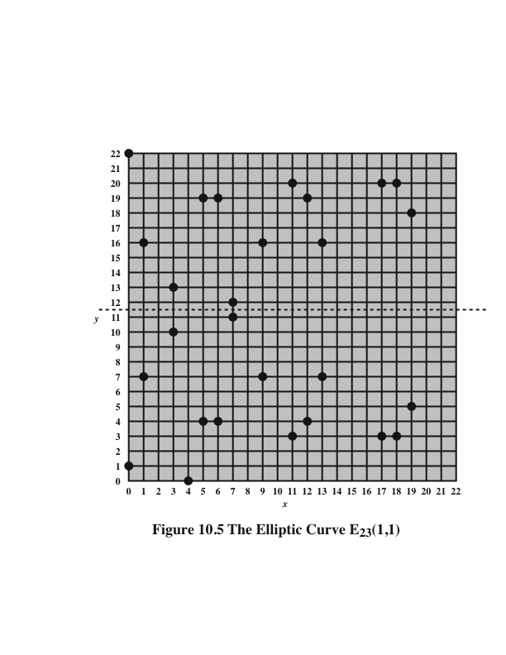
Notes:
Figure 10.5 plots the points of E₂₃ (1, 1); note that the points, with one exception, are symmetric about y = 11.5.

Slide 16
Elliptic Curves Over GF(2^{m})
Use a cubic equation in which the variables and coefficients all take on values in GF(2^{m}) for some number m
Calculations are performed using the rules of arithmetic in GF(2^{m})
The form of cubic equation appropriate for cryptographic applications for elliptic curves is somewhat different for GF(2^{m}) than for Z_{p}
  It is understood that the variables x and y and the coefficients a and b are elements of GF(2^{m}) and that calculations are performed in GF(2^{m})
Notes:
Recall from Chapter 4 that a finite field GF(2^{m} ) consists of 2^{m} elements, together
with addition and multiplication operations that can be defined over polynomials.
For elliptic curves over GF(2^{m} ), we use a cubic equation in which the variables and
coefficients all take on values in GF(2^{m} ) for some number m and in which calculations
are performed using the rules of arithmetic in GF(2^{m} ).
It turns out that the form of cubic equation appropriate for cryptographic applications
for elliptic curves is somewhat different for GF(2^{m} ) than for Z_{p} . The form is
y² + xy = x³ + ax² + b

Slide 17
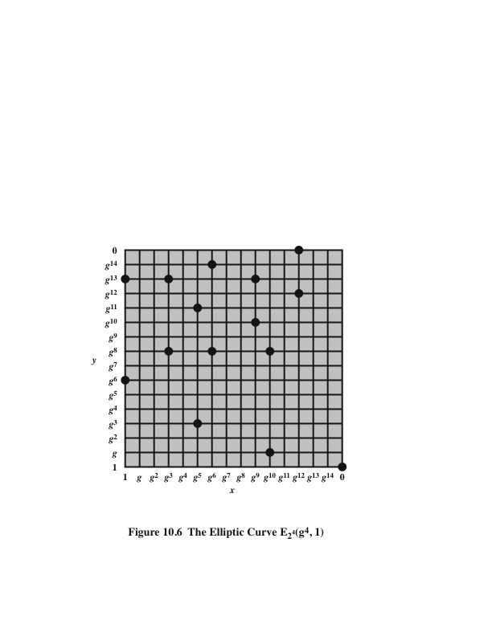
Notes:
Figure 10.6 plots
the points of E₂₄ (g⁴ , 1).

Slide 18
Elliptic Curve Cryptography (ECC)
Addition operation in ECC is the counterpart of modular multiplication in RSA
Multiple addition is the counterpart of modular exponentiation
Certicom example: E₂₃(9,17)
To form a cryptographic system using elliptic curves, we need to find a “hard problem” corresponding to factoring the product of two primes or taking the discrete logarithm
Q=kP, where Q, P belong to a prime curve
Is “easy” to compute Q given k and P
But “hard” to find k given Q, and P
Known as the elliptic curve logarithm problem
Notes:
Elliptic Curve Cryptography uses addition as an analog of modulo multiply, and repeated addition as an analog of modulo exponentiation. The “hard” problem is the elliptic curve logarithm problem. We give an example taken from the Certicom Web site (www.certicom.com). Consider the group E₂₃(9, 17). This is the group defined by the equation y² mod 23 = (x³ + 9x + 17) mod 23. What is the discrete logarithm k of Q = (4, 5) to the base P = (16, 5)? The brute-force method is to compute multiples of P until Q is found. Thus P = (16, 5); 2P = (20, 20); 3P = (14, 14); 4P = (19, 20); 5P = (13, 10); 6P = (7, 3); 7P = (8, 7); 8P = (12, 17) ; 9P = (4, 5). Because 9P = (4, 5) = Q, the discrete logarithm Q = (4, 5) to the base P = (16, 5) is k = 9. In a real application, k would be so large as to make the brute-force approach infeasible.

Slide 19
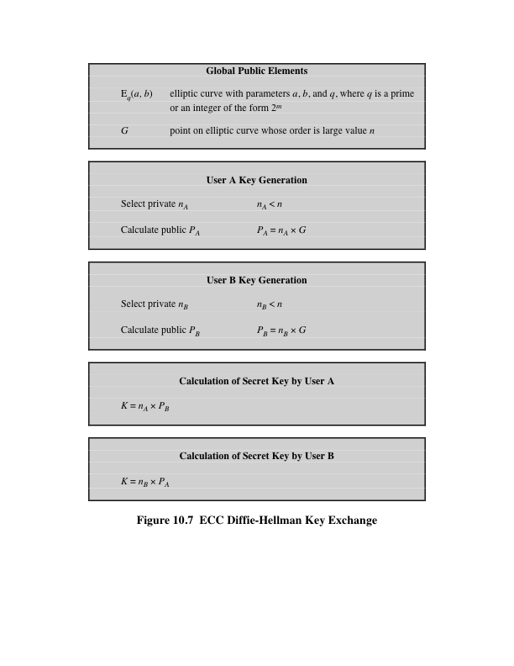
Notes:
Figure 10.7 ECC Diffie-Hellman Key Exchange.

Slide 20
ECC Encryption/Decryption
Several approaches using elliptic curves have been analyzed
Must first encode any message m as a point on the elliptic curve P_{m}
Select suitable curve and point G as in Diffie-Hellman
Each user chooses a private key n_{A} and generates a public key P_{A}=n_{A} * G
To encrypt and send message P_{m} to B, A chooses a random positive integer k and produces the ciphertext C_{m} consisting of the pair of points:
  C_{m} = {kG, P_{m}+kP_{B}}
To decrypt the ciphertext, B multiplies the first point in the pair by B’s secret key and subtracts the result from the second point:
P_{m}+kP_{B}–n_{B}(kG) = P_{m}+k(n_{B}G)–n_{B}(kG) = P_{m}
Notes:
Several approaches to encryption/decryption using elliptic curves have been analyzed in the literature. This one is an analog of the ElGamal public-key encryption algorithm. The sender must first encode any message M as a point on the elliptic curve P_{m} (there are relatively straightforward techniques for this). Note that the ciphertext is a pair of points on the elliptic curve. The sender masks the message using random k, but also sends along a “clue” allowing the receiver who know the private-key to recover k and hence the message. For an attacker to recover the message, the attacker would have to compute k given G and kG, which is assumed hard.

Slide 21
Security of Elliptic Curve Cryptography
Depends on the difficulty of the elliptic curve logarithm problem
Fastest known technique is “Pollard rho method”
Compared to factoring, can use much smaller key sizes than with RSA
For equivalent key lengths computations are roughly equivalent
Hence, for similar security ECC offers significant computational advantages
Notes:
The security of ECC depends on how difficult it is to determine k given kP and P .
This is referred to as the elliptic curve logarithm problem. The fastest known technique
for taking the elliptic curve logarithm is known as the Pollard rho method.

Slide 22
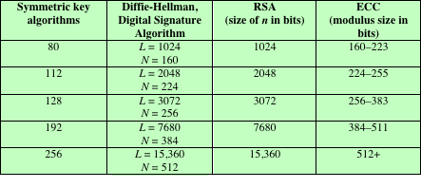
Table 10.3
Comparable Key Sizes in Terms of Computational Effort for Cryptanalysis
(NIST SP-800-57)
Note: L = size of public key, N = size of private key
Notes:
Table 10.3, from NIST SP800-57 (Recommendation for Key Management—Part 1:
General , July 2012), compares various algorithms by showing comparable key sizes
in terms of computational effort for cryptanalysis. As can be seen, a considerably
smaller key size can be used for ECC compared to RSA. Furthermore, for equal
key lengths, the computational effort required for ECC and RSA is comparable
[JURI97]. Thus, there is a computational advantage to using ECC with a shorter
key length than a comparably secure RSA.

Slide 23
Pseudorandom Number Generation (PRNG) Based on Asymmetric Cipher
An asymmetric encryption algorithm produces apparently ransom output and can be used to build a PRNG
Much slower than symmetric algorithms so they’re not used to generate open-ended PRNG bit streams
Useful for creating a pseudorandom function (PRF) for generating a short pseudorandom bit sequence
Notes:
We noted in Chapter 7 that, because a symmetric block cipher produces an apparently random output, it can serve as the basis of a pseudorandom number generator (PRNG). Similarly, an asymmetric encryption algorithm produces apparently random output and can be used to build a PRNG. Because asymmetric algorithms are typically much slower than symmetric algorithms, asymmetric algorithms are not used to generate open-ended PRNG bit streams. Rather, the asymmetric approach is useful for creating a pseudorandom function (PRF) for generating a short pseudorandom bit sequence. In this section, we examine two PRNG designs based on pseudorandom functions.

Slide 24
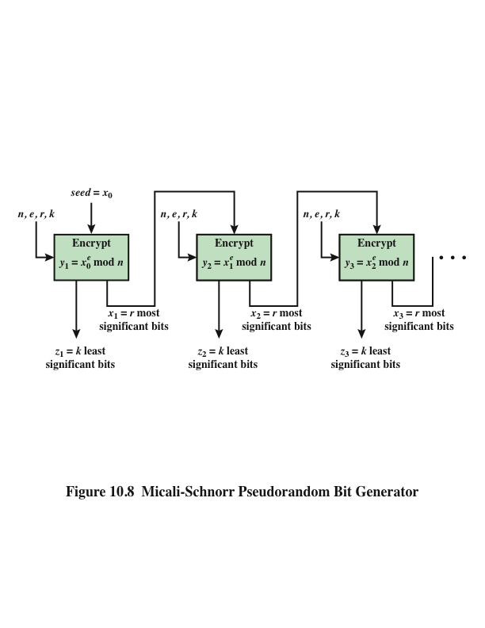
Notes:
For a sufficient key length, the RSA algorithm is considered secure and is a good candidate to form the basis of a PRNG. Such a PRNG, known as the Micali-Schnorr PRNG is recommended in the ANSI standard X9.82 (Random Number Generation) and in the ISO standard 18031 (Random Bit Generation). The PRNG is illustrated in Stallings Figure 10.8. This PRNG has much the same structure as the output feedback (OFB) mode used as a PRNG but using RSA instead of a block cipher. We can define the PRNG as follows:
SETUP Select parameters per normal RSA key setup, with r + k =bitlength of n
SEED Select a random seed x of bitlength the same as n
GENERATE a pseudorandom sequence of length k x m using the loop:
for i from 1 to m do the following:
y_{i} = x^{e}_{i-1} mod n
x_{i} = r most significant bits of y_{i}
z_{i} = k least significant bits of y_{i}
OUTPUT The output sequence is z₁ || z₂ || … || z_{m}
The parameters n, r, e, and k are selected to satisfy the six conditions detailed in the text. There is clearly a tradeoff between r and k. Because RSA is computationally intensive, we would like to generate as many pseudorandom bits per iteration as possible, and therefore would like a large value of k. However, for cryptographic strength, we would like r to be as large as possible.

Slide 25
PRNG Based on Elliptic Curve Cryptography
Developed by the U.S. National Security Agency (NSA)
Known as dual elliptic curve PRNG (DEC PRNG)
Recommended in NIST SP 800-90, the ANSI standard X9.82, and the ISO standard 18031
Has been some controversy regarding both the security and efficiency of this algorithm compared to other alternatives
  The only motivation for its use would be that it is used in a system that already implements ECC but does not implement any other symmetric, asymmetric, or hash cryptographic algorithm that could be used to build a PRNG
Notes:
In this subsection, we briefly summarize a technique developed by the U.S. National Security Agency known as dual elliptic curve PRNG (DEC PRNG). This technique is recommended in NIST SP 800-90, the ANSI standard X9.82 and in the ISO standard 18031. There has been some controversy regarding both the security and inefficiency of this algorithm compared to other alternatives. Can summarize the algorithm as follows: Let P and Q be two known points on a given elliptic curve. The seed of the DEC PRNG is a random integer s₀ Let x denote a function that gives the x-coordinate of a point of the curve. Let lsb _{i}(s) denote the i least significant bits of an integer s. The DEC PRNG transforms the seed into the pseudorandom sequence of length 240k, k > 0, as follows.
for i = 1 to k do
set s_{i} = x(s_{i-1} P )
set r_{i} = lsb₂₄₀ (x(s_{i} Q))
end for
return r₁ , . . . , r_{k}
Given the security concerns expressed for this PRNG, the only motivation for its use would be that it is used in a system that already implements ECC but does not implement any other symmetric, asymmetric, or hash cryptographic algorithm that could be used to build a PRNG.

Slide 26
Summary
Diffie-Hellman Key Exchange
  The algorithm
  Key exchange protocols
  Man-in-the-middle attack
Elgamal cryptographic system
Elliptic curve cryptography
  Analog of Diffie-Hellman key exchange
  Elliptic curve encryption/decryption
  Security of elliptic curve cryptography
Elliptic curve arithmetic
  Abelian groups
  Elliptic curves over real numbers
  Elliptic curves over Z_{p}
  Elliptic curves over GF(2^{m})
Pseudorandom number generation based on an asymmetric cipher
  PRNG based on RSA
  PRNG based on elliptic curve cryptography
Notes:
Chapter 10 summary.

